Slide 1
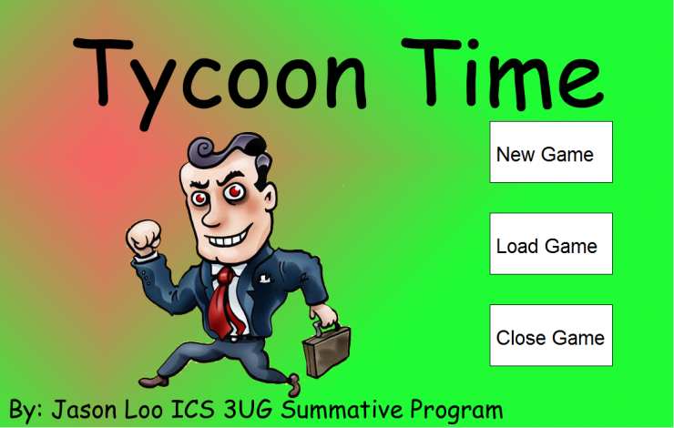


The Game we’ve all been waiting for
From the creator of
Quest For the Cube of Knowledge
Vion Genesis
For Windows

Slide 2

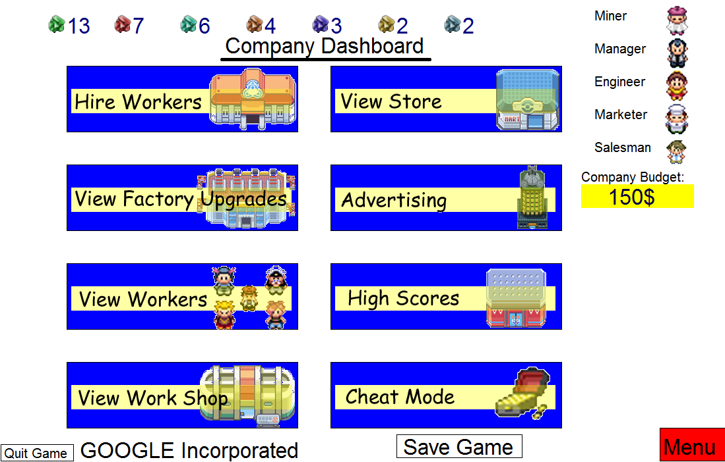

To build a company up from the ground?
Hire workers to improve efficiencies of your buildings
Increase factories to produce more resources
Build a multitude of items in your workshop
And sell them in your store
Prove to the bank that you are the ULTIMATE BUSINESS OWNER

Slide 3

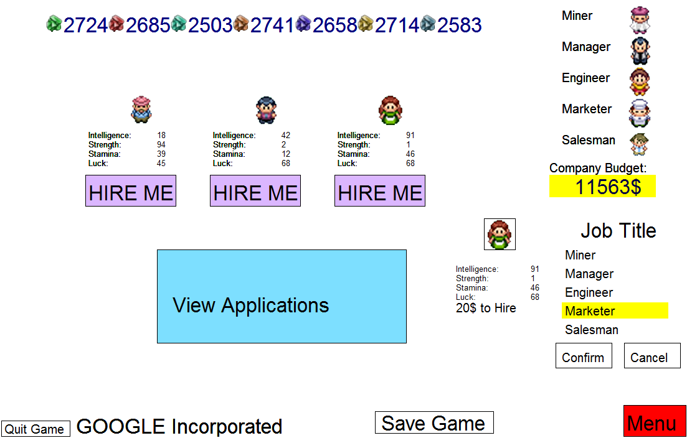
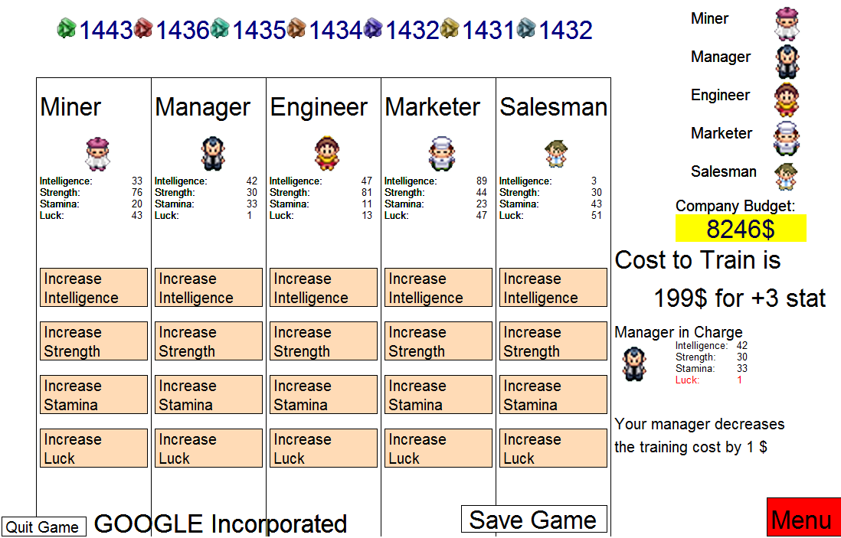
Employ a team of 5 Workers
  Miner
  Manager
  Engineer
  Marketer
  Salesman
Train them to their full potential!
But don’t forget to pay them

Slide 4

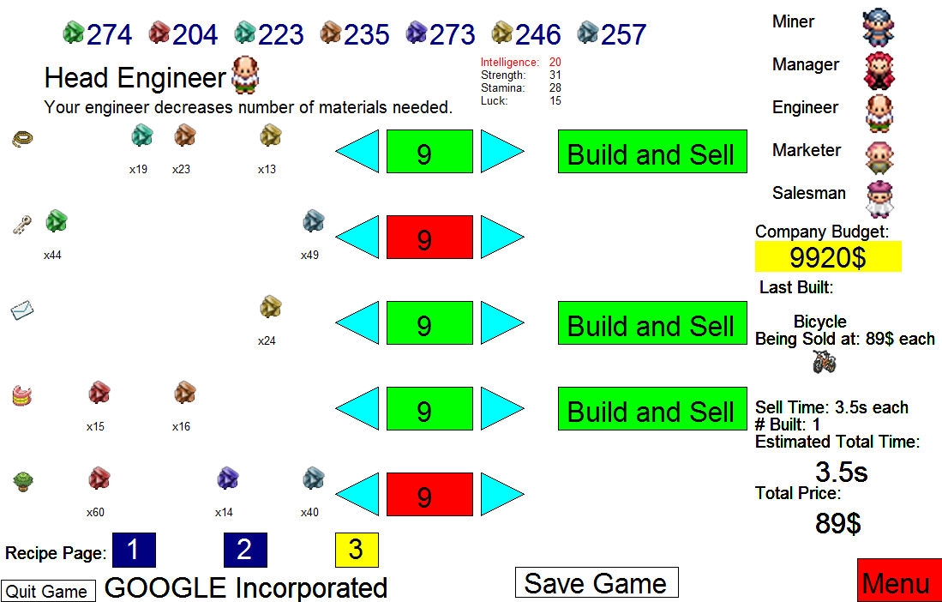
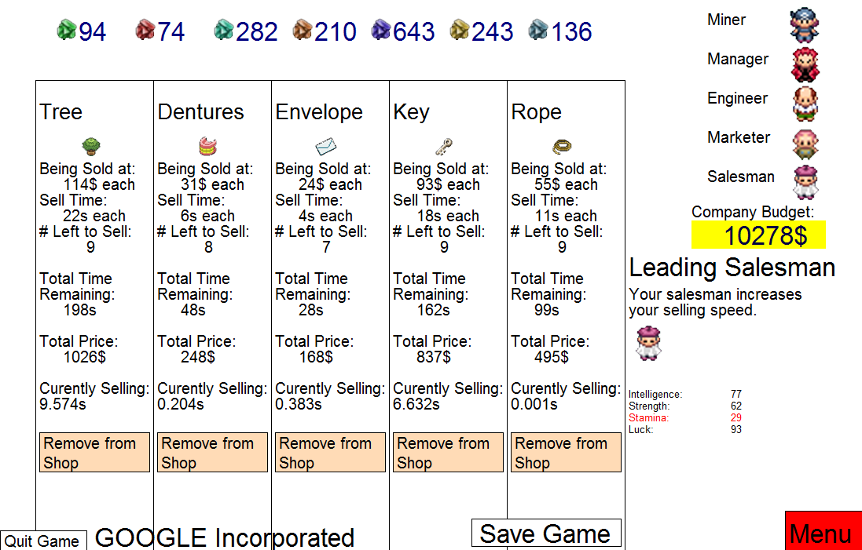
Build 15 different items in order to produce an income
Watch your products get sold IN REAL TIME

Slide 5

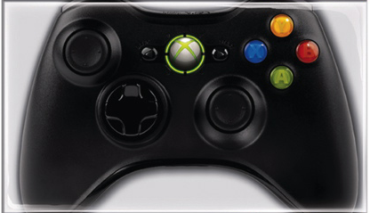

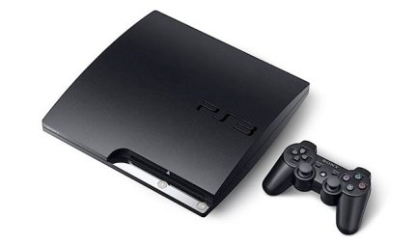
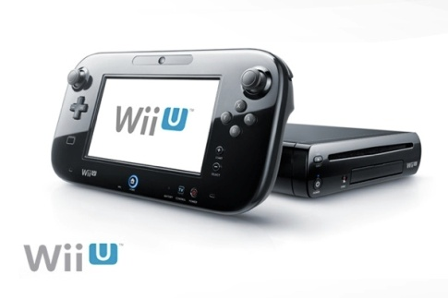
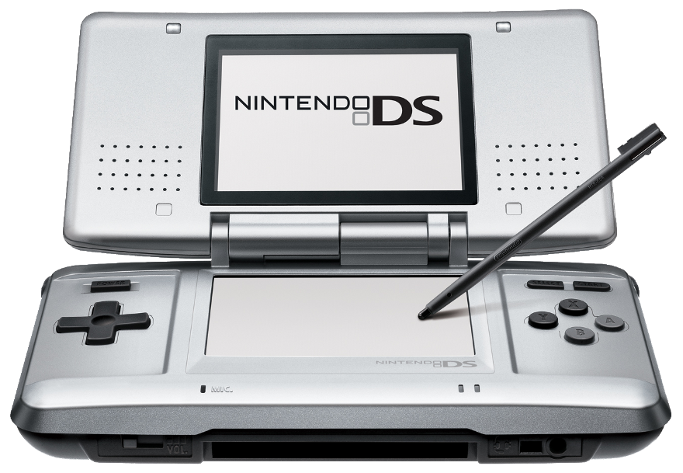

Currently available with:
  Turing 4.1
SOON TO BE COMPATIBLE WITH:
  XBOX 360
  Nintendo Wii U
  PS3
  PSP
  PSPGO
  Nintendo DS
  Nintendo DS Lite
  Nintendo DSI
  Nintendo DSIXL
  NintendoDSIXL360EVO2.0

